Slide 1
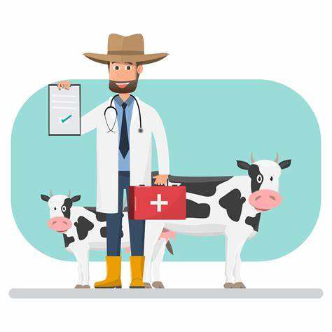
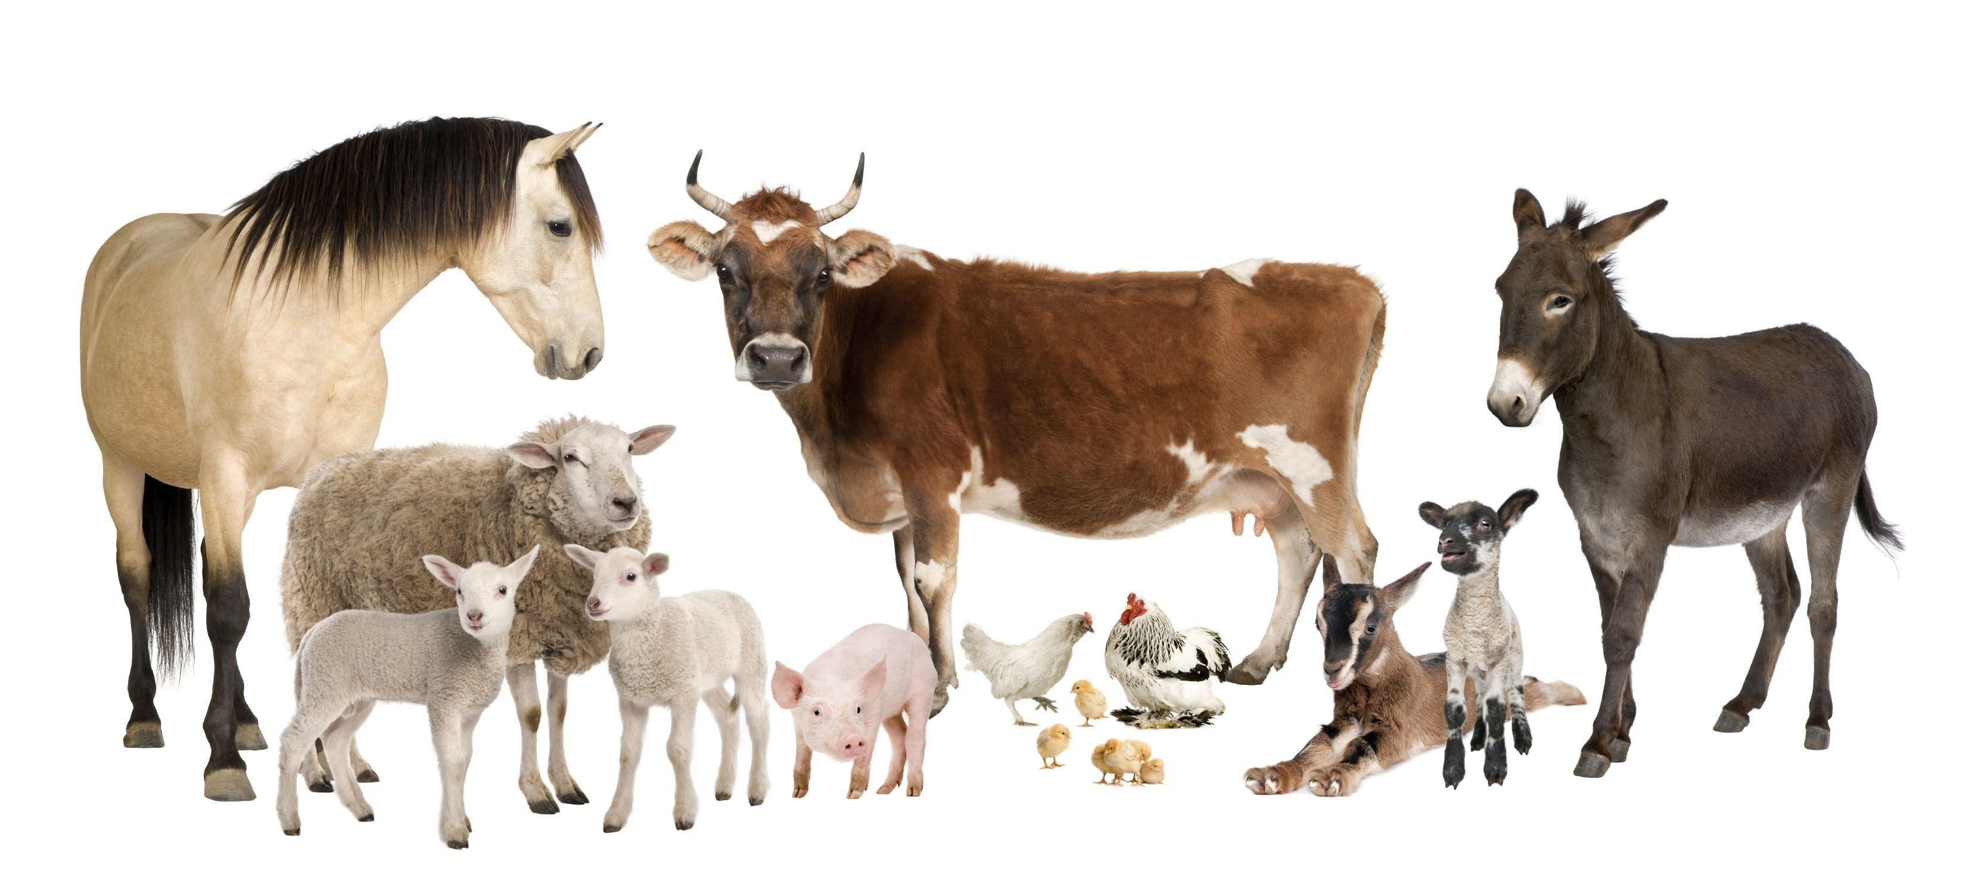
FarmCare miniproject
RRM Nkoana
Student number: 221033095

Slide 2
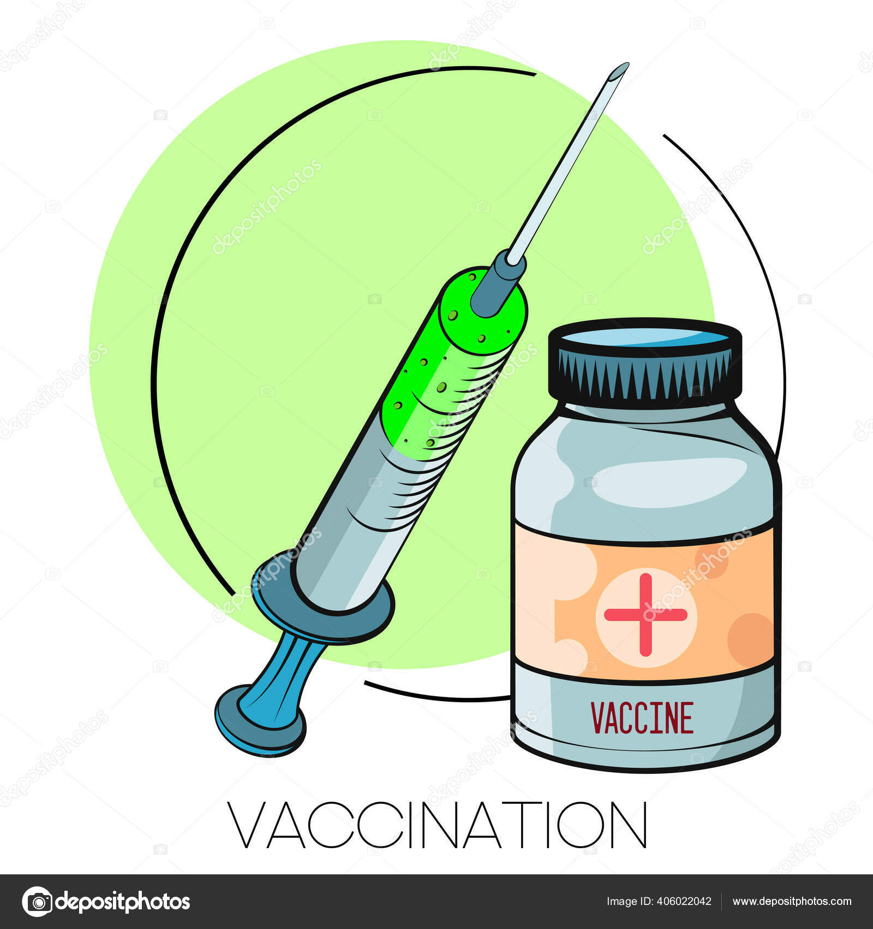
Introduction
Project: FarmCare
Animal Vaccination Tracking Management System
Modernizing farm management health tracking practices for animals
Tracking animal vaccination health records

Slide 3
Problem Background
Context:
Traditional farm management systems rely on manual record-keeping methods, such as paper-based or spreadsheet systems, to manage animal vaccination health records.
Challenges Farmers Face:
1. Time-consuming
2. Human errors
3. Lack of security

Slide 4
Problem Background
Research Problem:
Addressing the inefficiencies and vulnerabilities of traditional farm management systems to improve the accuracy, efficiency, and security of storing animal vaccination health record for farmers.
Existing or similar solutions:
FarmLogs: A popular digital farm management app that offers features for tracking crop data.
Herdwatch: An app specifically designed for livestock farmers.
CattleMax: Software tailored for cattle ranchers, providing tools for tracking individual animal records, performance metrics, and health history.

Slide 5

Solution
Farmcare aims to address the problem of manual farm vaccination tracking management systems by creating a digitalized system were farmers can register , logging and track all their animals vaccinations records to a blockchain. Farmers can add their records too into the blockchain.
The system and the blockchain technology will provide farmers a :
Secure and immutable
Efficient
User-friendly solution
Overall, while existing solutions offer some digitalization of farm management, they often lack the comprehensive features, integration, and security provided by a blockchain-based solution like FarmCare.

Slide 6
Key Solutions Logic and Complexity
Logic:
One to many registered clients establishing a connection to the server , to add and retrieving user and animal data, then populating various charts, tables and fields based on the received data. Each user will have a session based on their user ID.
Utilizing blockchain : The farmer will be able store the following transaction records for each animal for each user:
Animals Name
Type of animal
Animals breed
Animal date of birth
Vaccinated?
Justification for transactions : Ensures tamper-proof and transparent recording of critical animal transaction data such as name, type, breed, date of birth, and vaccination status. This guarantees data integrity, enhances traceability, and facilitates compliance with regulatory standards, thereby improving overall farm management efficiency and animal welfare.

Slide 7
Key Solutions Logic and Complexity
Interfaces:
Java FXML Pages
Data structures
Maps (HashMap), Regex (Regular Expression), Lists, ArrayLists and Arrays
Algorithms:
Hashing: to hash the users data such as their passwords (SHA-256) and to hash blocks
External libraries:
JavaFX Charts, Java FXML (FXMLLoader), blockain.jar

Slide 8
Novelty
Blockchain brings new innovation in agriculture
Data security assurance
Farmer-friendly interface

Slide 9
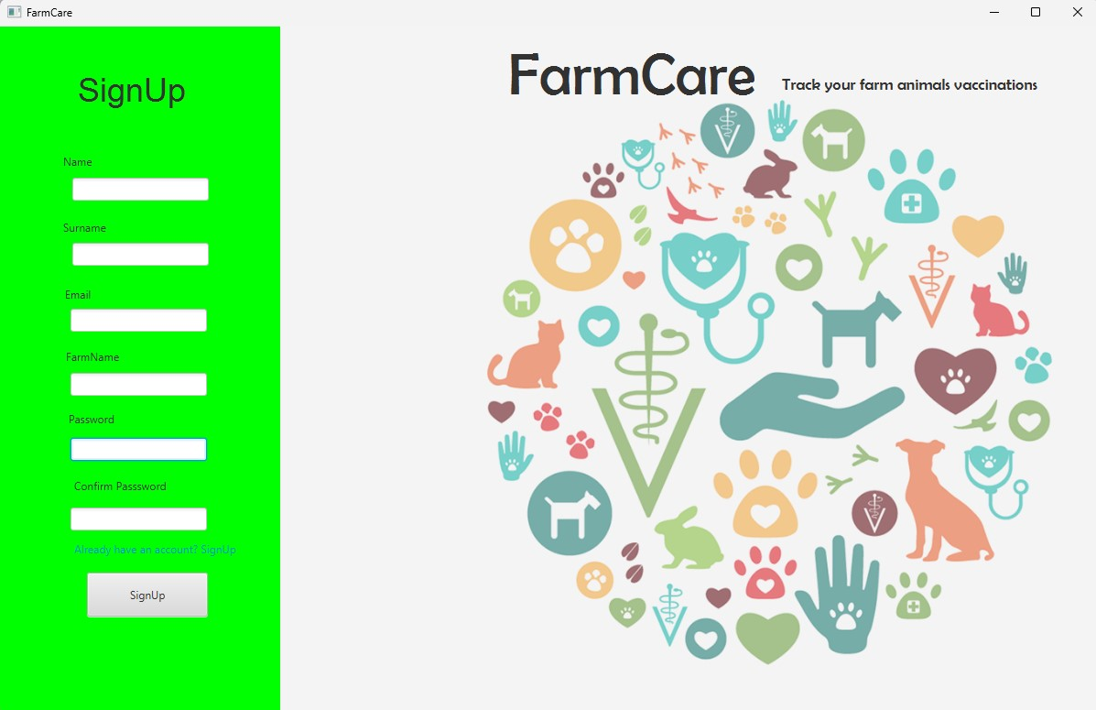
GUI: Signup/Register

Slide 10
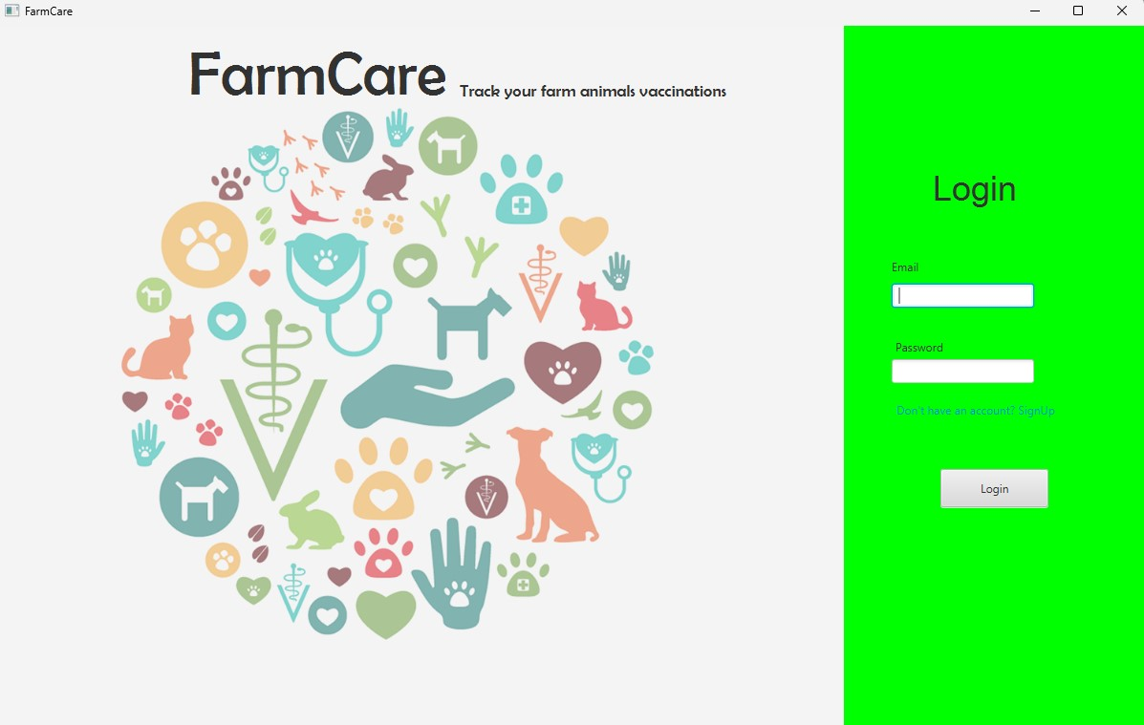
GUI: Login

Slide 11
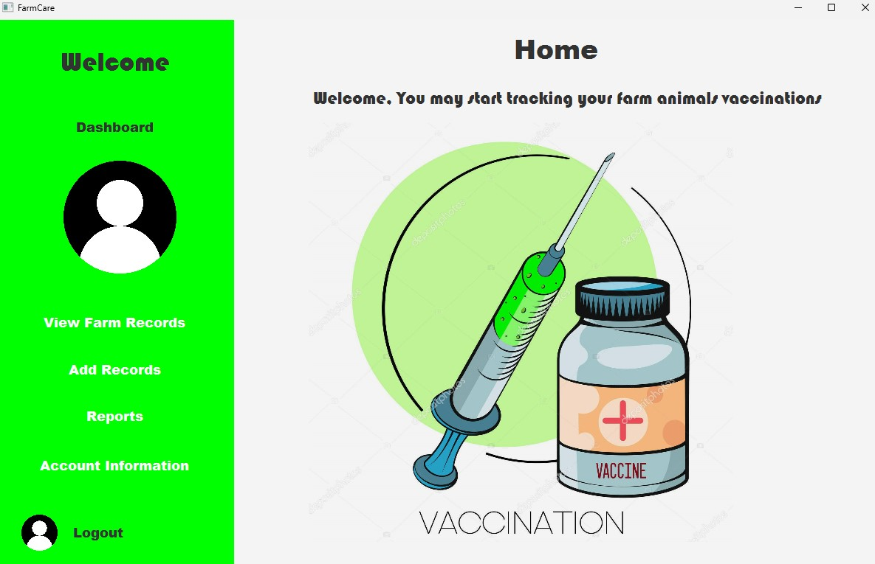
GUI: Home Dashboard

Slide 12
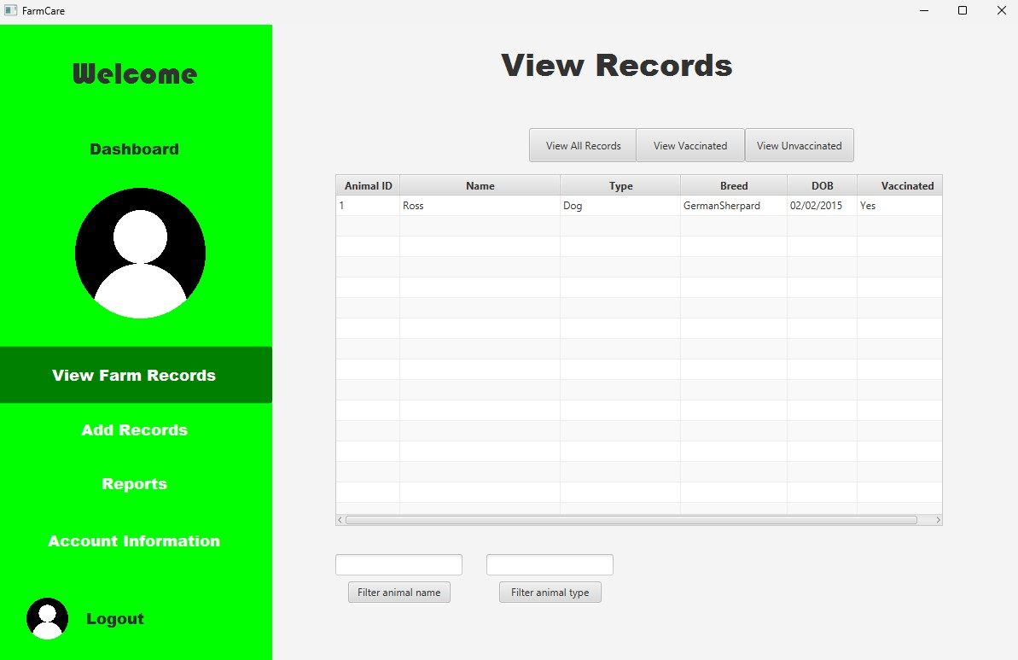
GUI: View Farm Records

Slide 13
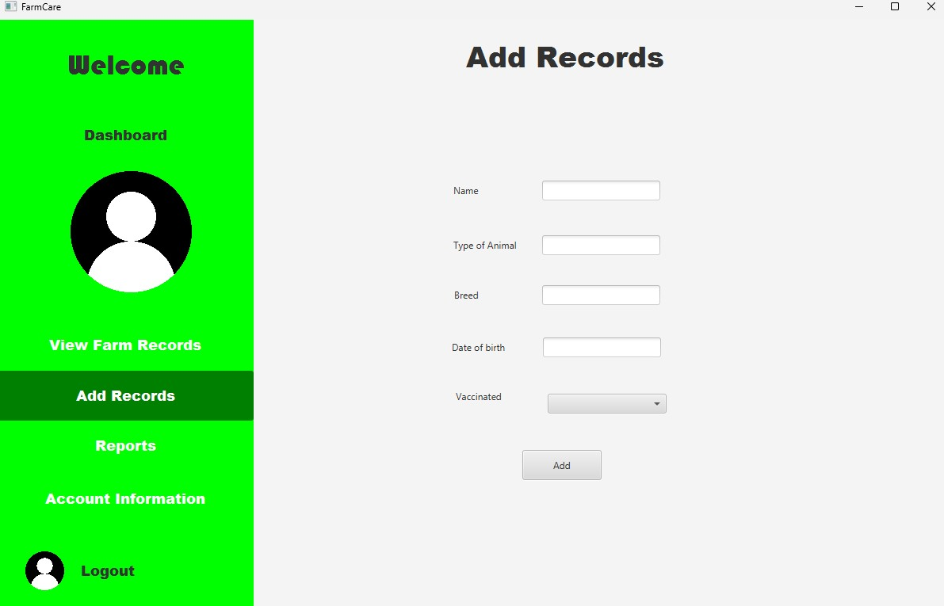
GUI: Add Farm Records

Slide 14
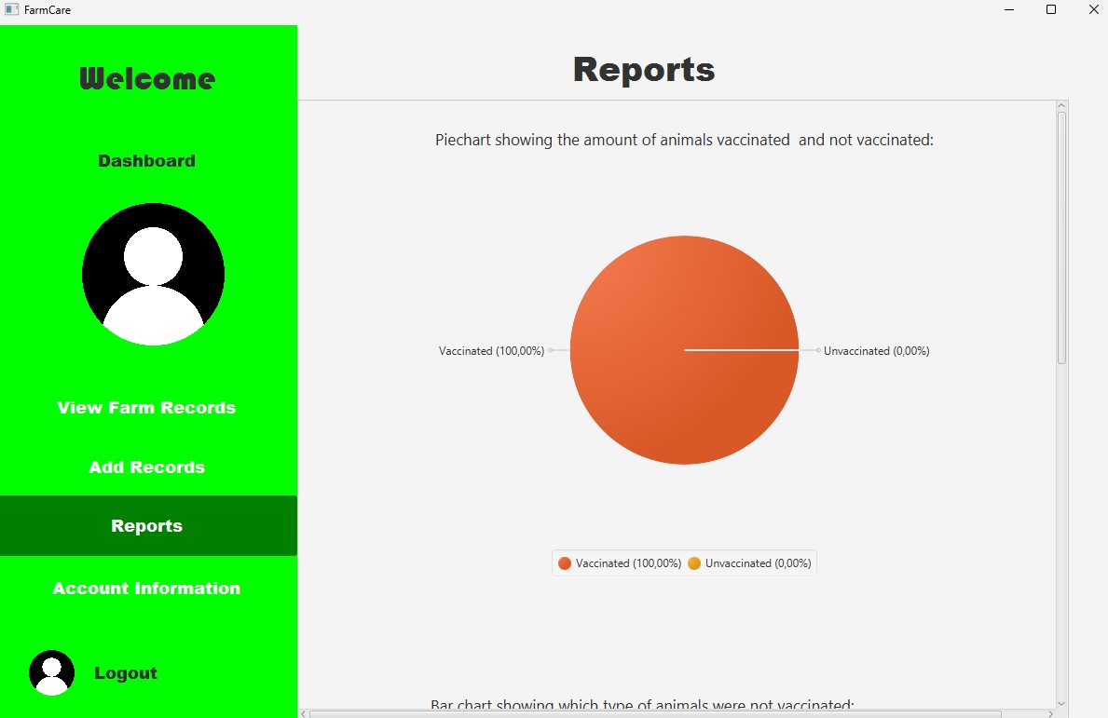
GUI: Farm Reports

Slide 15
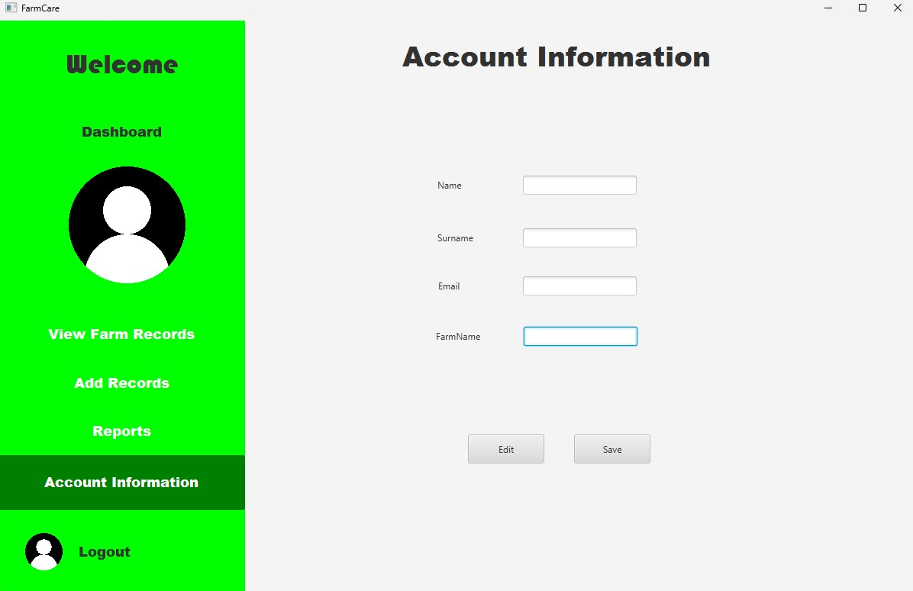
GUI: User Account Information

